Slide 1
PBIO 4733-001, PBIO 5733-001, GIS 4733-001, GIS 5733-001 Environmental Remote Sensing (Spring 2018) The 2nd Student Project Surface Water Body Mapping In Himalayan Region
Palakurthy Dheeraj Srivathsav Data science and Analytics Graduation 05-01-2018

Slide 2
Introduction:
Global warming appears to be rapidly accelerating temperature elevations in certain high-altitude zones, particularly those
nearest the equator, which includes the Greater Himalayas.
This increase in the temparatures will result in the melting of the North and South Poles which may raise ocean levels with disastrous effect. The melting of these Himalayan glaciers will have a more direct long-term effect on the hundreds of millions
of people who live along rivers fed by their seasonal runoff.
Scientists warn that by 2070 there could be a 43 percent decrease in land mass covered by these once seemingly eternal aspects of our planet’s architecture
Hence in this project I find the opportunity to observe the effects of the Global warming on the Himalayas. For this I have
selected two study areas named Wular Lake and the Dal Lake which are in very very close to the Himalayan Mountain Ranges.
So, by observing the surface area of these lakes over a period of time will indicate the effect of Global Warming on Himalayas.
For this mapping I have used Google Earth Engine as a Platform for the analysis.

Slide 3
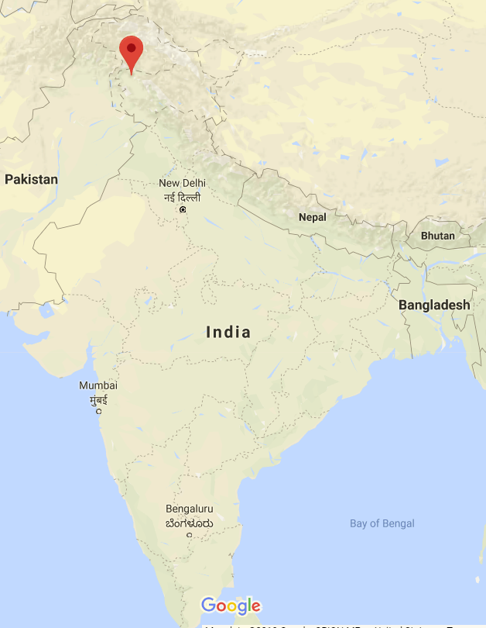
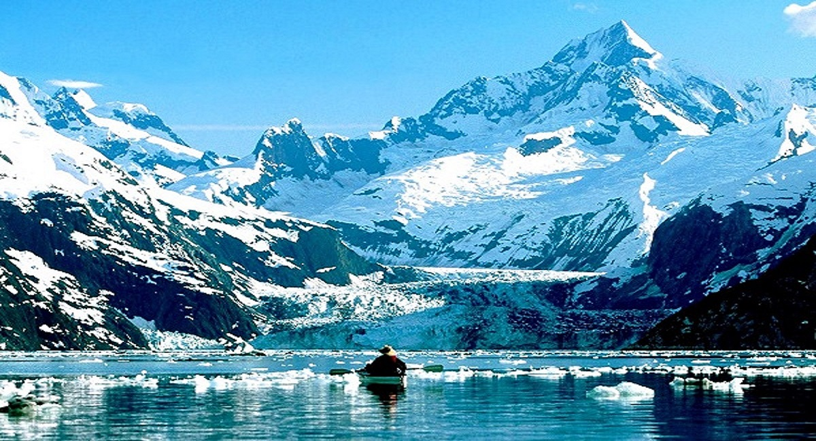
2.1 Study Area:
Wular Lake is one of the largest fresh water lakes in Asia. It is sited in Bandipora district in the Indian state of Jammu and Kashmir.
The lake's size varies seasonally from 12 to 100 square miles (30 to 260 square kilometers)

Slide 4
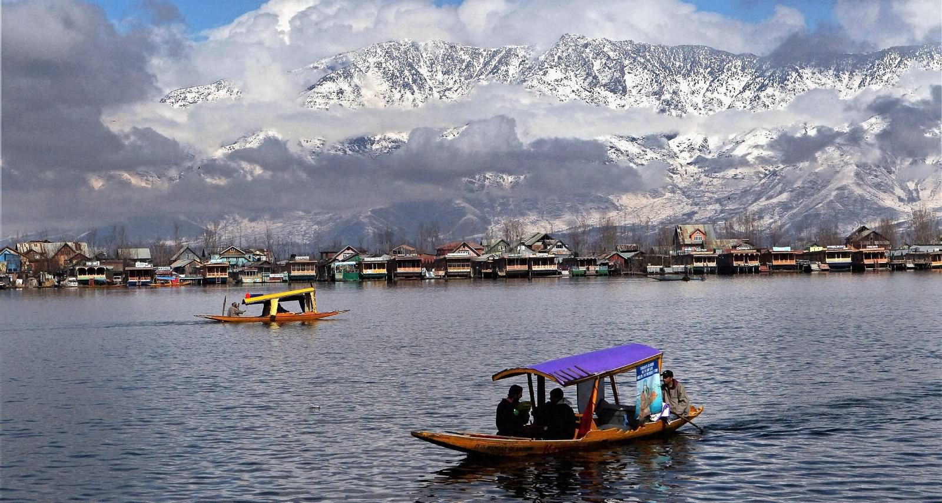
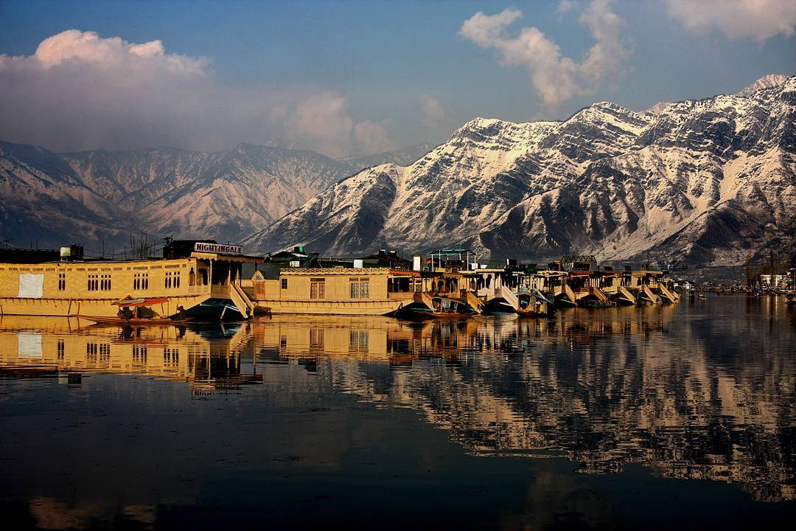
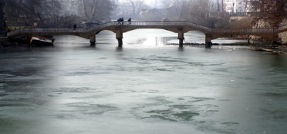
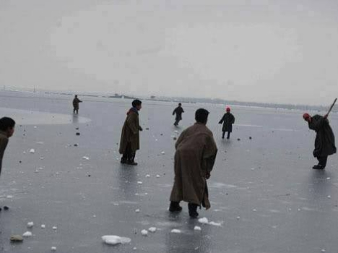
It is integral to tourism and recreation in Kashmir and is named the "Jewel in the crown of Kashmir" or "Srinagar's Jewel".

Slide 5
2.2 Data:
The study area on which I am working does not have much of good satellite images as it was very close to the
mountain ranges. Hence I have used three satellite sensors LANDSAT 5, LANDSAT 7 and LANDSAT 8 for the image
collection and used the one best image during a specific time interval. For the Time series analysis of 5 years I have used
5 best images during each time Interval.
2.3 Methods:
Task 1: Comparing two different algorithms for the surface water body mapping using MNDWI vegetative
Index and the Machine Learning classification techniques like Random forest and SVM (Support vector
machines) for two regions Wullar lake and the Dal lake.
Task 2: Time Series Analysis of Wullar lake from 2013-2017 using MNDWI Vegetative Index.

Slide 6
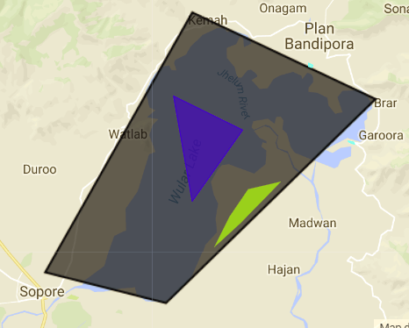
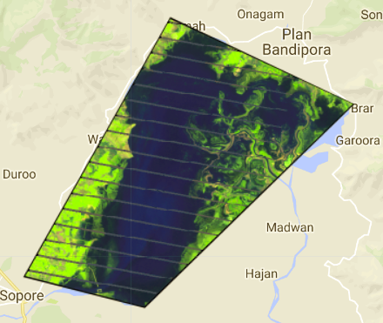
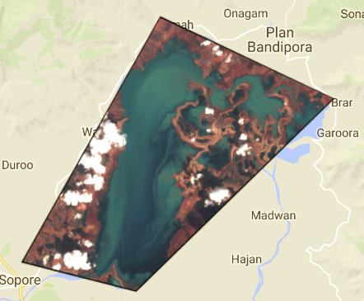
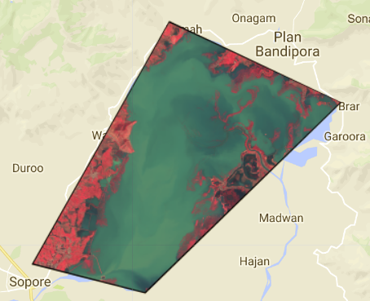
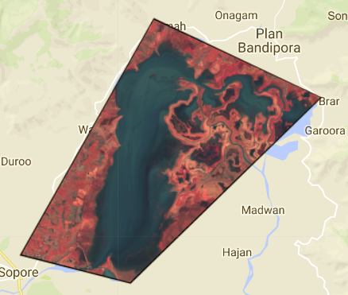
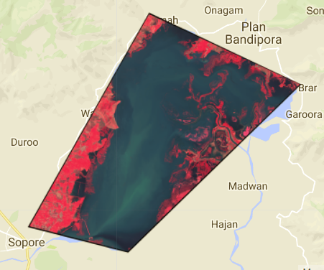
Results: Task 1-Method1
Step-1: Selecting the best satellite Image throughout the year 2017 in Wullar lake. Results show some of the satellite Images
in that region.

Slide 7
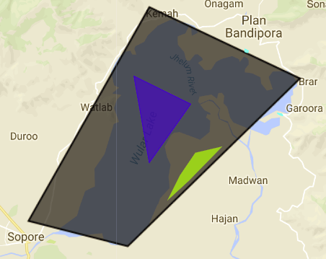
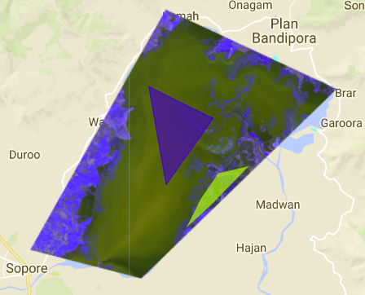
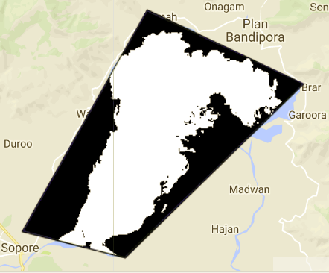
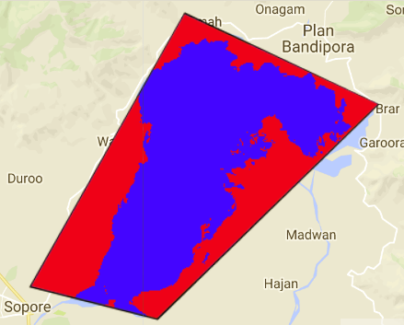
Step-2: Results after classification using Random Forest and converting it to a Binary Image
Original Image
Landsat-8 Image
Image After Classification
Binary Image

Slide 8
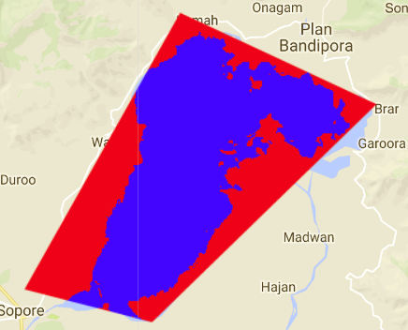
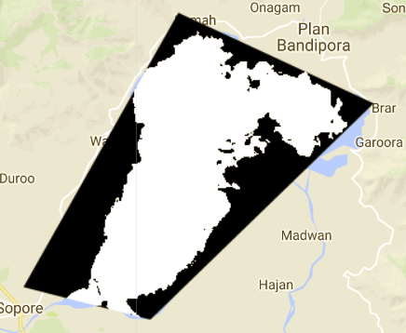
Step-2: Results after classification using Support Vector Mechine and converting it to a Binary Image
Original Image
Landsat-8 Image
Image After Classification
Binary Image

Slide 9
Step-3: Random forest VS SVM for basic Training Samples
Training Samples:
Water: 1 polygon
Grassland: 1 Polygon
Forest: 2 Polygons
Area of the surface water: 102011.4
Water: 3 polygon
Grassland: 3 Polygon
Forest: 2 Polygons
Area of the surface water: 102015.4
Training Samples:
Water: 1 polygon
Grassland: 1 Polygon
Forest: 2 Polygons
Area of the surface water: 103148.79
Water: 3 polygon
Grassland: 3 Polygon
Forest: 2 Polygons
Area of the surface water: 103291.91

Slide 10
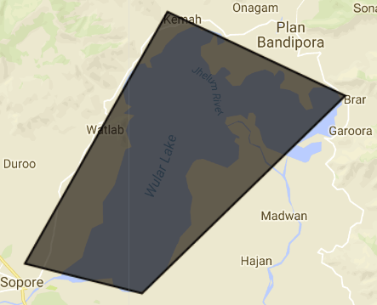
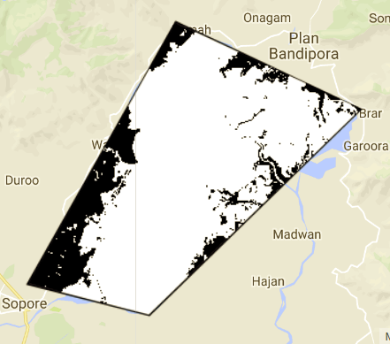
Method 2: surface water body mapping using MNDWI vegetative Index
Here in this method I have calculated the MNDWI vegetative Index of the study area and set the threshold value by
Observing different pixels of water body and the non-water body and considered values with MNDWI values greater
than zero as water body and less than zero as non-water body.
Original Image
Binary Image after setting
the Threshold values

Slide 11
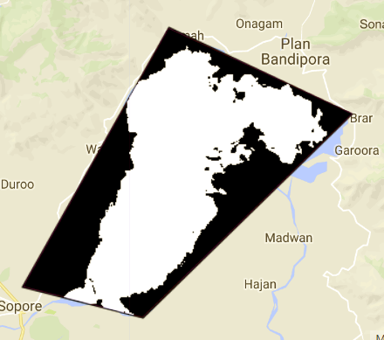
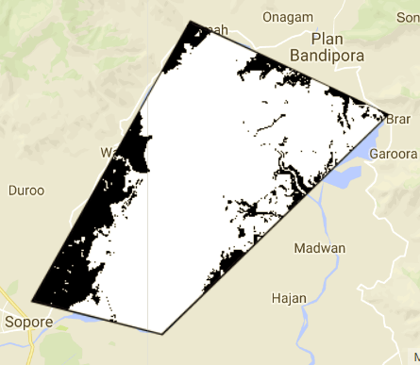
Comparison of the Algorithms:
Mapping the Water surface by Predicting
the image using the Training Samples
Classifiers: Random Forest, SVM
Mapping the Water surface by calculating the MNDWI values by setting the Threshold
values
Area of the surface water: 103291.91
Area of the surface water: 164338.50

Slide 12
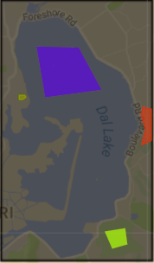
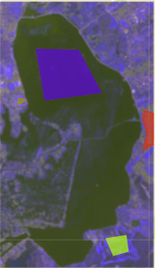
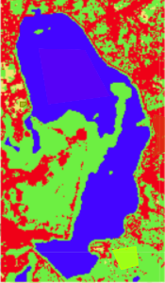
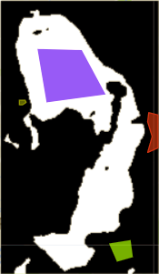
Evaluating the same Task for different study area: Dal Lake
Step-1: Repeated the step-1 similar to the before study area (Wullar Lake)
Step-2: Results after classification using Random Forest and converting it to a Binary Image
Original Image
Landsat Image
Classified Image
Binary Image

Slide 13
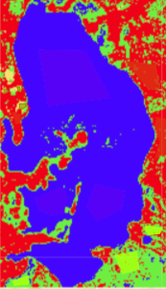
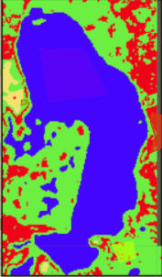
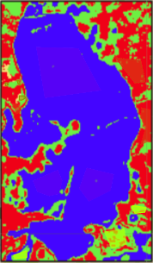
Step-3: Random forest VS SVM for basic Training Samples
Training Samples:
Water: 1 polygon
Urban: 1 Polygon
Grassland: 1 Polygon
Forest: 1 Polygons
Area of the surface water: 12799.38
Water: 3 polygon
Urban: 3 Polygon
Grassland: 3 Polygon
Forest: 2 Polygons
Area of the surface water: 20380.00
Training Samples:
Water: 1 polygon
Urban: 1 Polygon
Grassland: 1 Polygon
Forest: 1 Polygons
Area of the surface water: 102011.4
Water: 3 polygon
Urban: 3 Polygon
Grassland: 3 Polygon
Forest: 2 Polygons
Area of the surface water: 16272.64

Slide 14
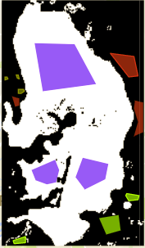
Result of Increase in the Training Samples:
Training Samples:
Water: 1 polygon
Urban: 1 Polygon
Grassland: 1 Polygon
Forest: 1 Polygons
Area of the surface water: 12799.38
Training Samples:
Water: 3 polygon
Urban: 3 Polygon
Grassland: 3 Polygon
Forest: 2 Polygons
Area of the surface water: 20380.00

Slide 15
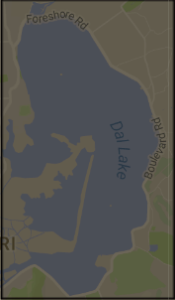
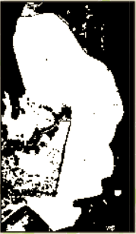
Method 2: surface water body mapping using MNDWI vegetative Index
Here in this method I have calculated the MNDWI vegetative Index of the study area and set the threshold value by \
Observing different pixels of water body and the non-water body and considered values with MNDWI values greater
than zero as water body and less than zero as non-water body.
Original Image
Binary Image after setting
the Threshold values

Slide 16
Comparison of the Algorithms:
Mapping the Water surface by Predicting
the image using the Training Samples
Classifiers: Random Forest, SVM
Mapping the Water surface by calculating the MNDWI values by setting the Threshold
values
Area of the surface water: 20380.00
Area of the surface water: 25048.23

Slide 17
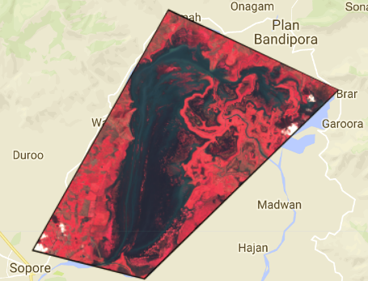
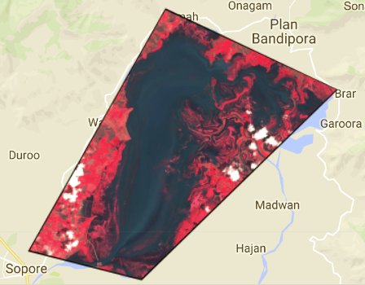
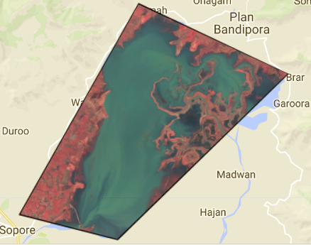
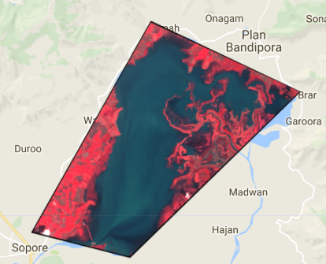
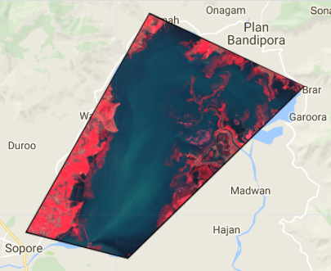
Task 2:Time Series Analysis of Wullar lake from 2013-2017 using MNDWI Vegetative Index.
Best Image In 2013
Best Image In 2014
Best Image In 2015
Best Image In 2016
Best Image In 2017

Slide 18
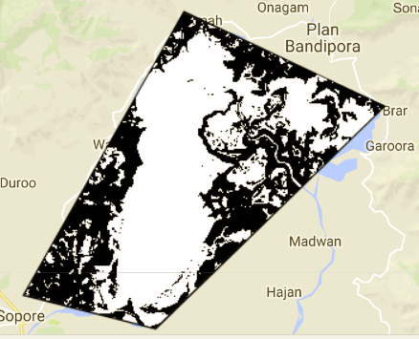
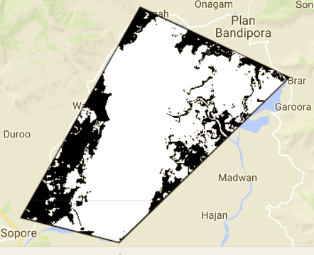
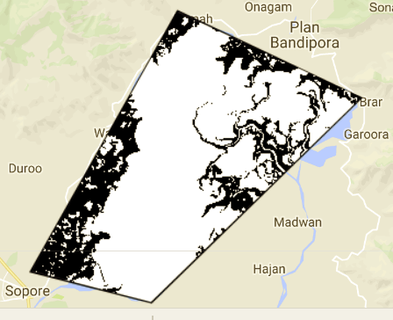
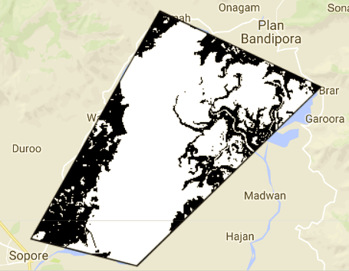
2013: Area of the surface water: 122173.03
2014: Area of the surface water: 151507.68
2015: Area of the surface water: 152759.00
2016: Area of the surface water: 144855.30

Slide 19
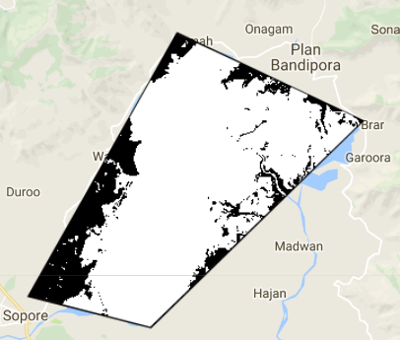
2017: Area of the surface water: 164338.50

Slide 20
Discussion :
TASK-1: Areas of Improving the Model
The accuracy of the classifier increases with increase in the training samples. The more the training samples are the better the model gets trained and we there is a high chance of getting better predictions.
The results of the classifier model can be improved in areas where there are good number of satellite images and also being most similar to the original Image.
The major area of improving the results will happen when we apply Hyper parameter tuning and cross validation techniques to our classifier i.e by increasing the no.of iterations or tuning a particular parameter based on the technique we are using.
There are several other classification techniques like Naive Bayes, Logistic Regression, Decision trees, Adaboost, Black Boost , Artificial Neural Networks etc. By applying these methods we can verify whether there is an improvement in the results or not.

Slide 21
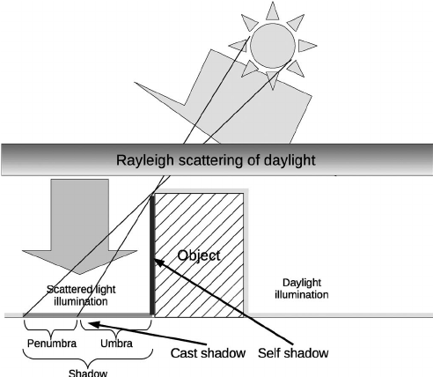
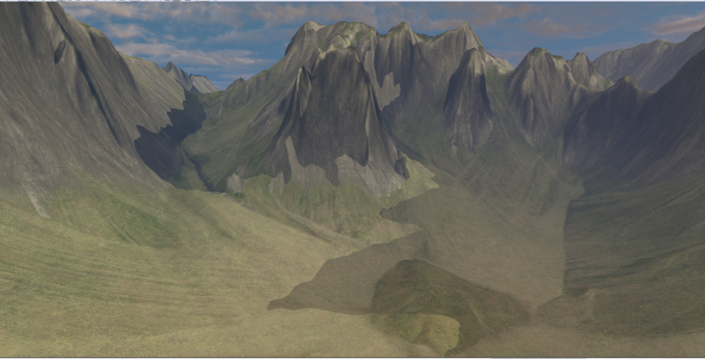
TASK-2: Effects on satellite Images in the Mountain Terrain
There are several effects on the satellite Images in the Mountain Terrains. Some of the very important ones are:
Cast Shadows and Self Shadows :
Variation of Ground slope :
The variation of ground slope must be accounted for in both the solar and sky irradiance components.

Slide 22
Summary:
TASK-1: Comparison of Algorithms
I have observed the results for this task for two regions Wular Lake and the Dal Lake. Both of the results show that the
Water body mapping done using the MNDWI vegetative Index is better than the water body mapping done using the
Machine Learning Techniques to predict the water body based on the training samples.
Area of the surface water
Using classifier: 20380.00
Area of the surface water using MNDWI
Vegetative Index: 25048.23
TASK-2: Time Series Analysis of Wular Lake
We can see that there is an increase in area of the surface water level throughout the 5 years except for year 2016 where
there is a decrease in the trend. The reason for this unexpected decrease in 2016 is because there is no proper satellite
Image in this year. We can see from the above plots that the best satellite image of 2016 has a lot of variation w.r.t the
original image.
The major sources for increase in water level are either due to the melting of the Himalaya mountain rages due to
global warming or due to rainfall. With melting of the Himalayas new glaciers are formed and they are get merged into
These lakes.

Slide 23


